Slide 1
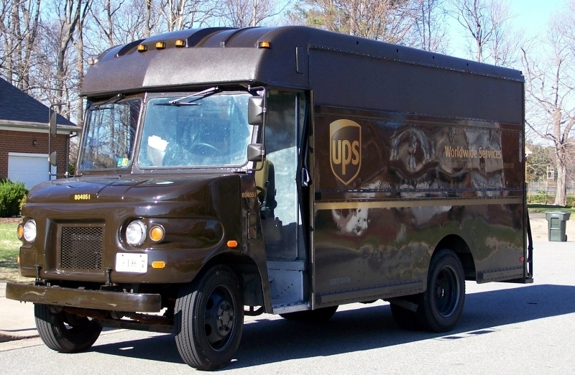
Financial Statement For UPS!!!
By: SHAKAYLA WILLIAMS AND ALEXIS CURRIN

Slide 2
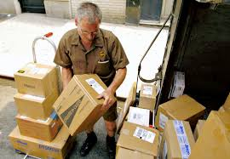
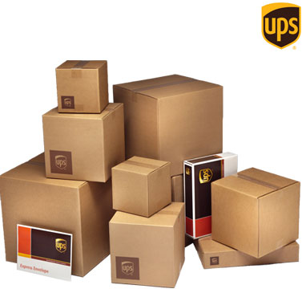
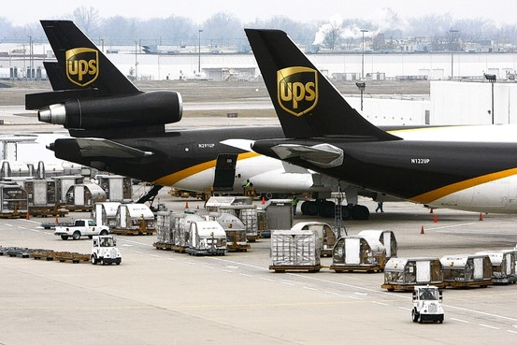
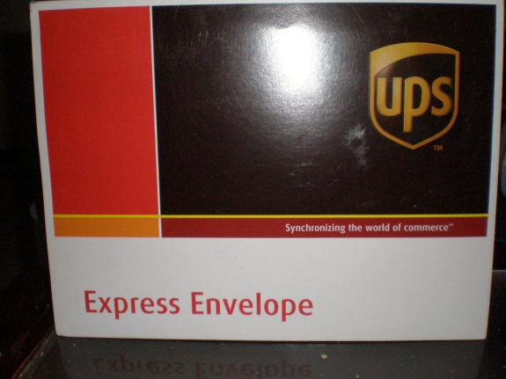

Slide 3
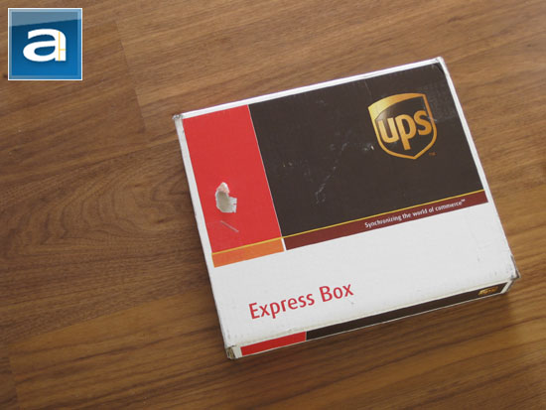
What is UPS?
UPS is a mailing service that helps you streamline and optimize your mailing process. It is the world's largest package delivery company and a provider of supply chain management solutions. The global logistics company is headquartered in Sandy Springs, Georgia, which is part of the Greater Atlanta area. UPS delivers more than 15 million packages a day to more than 6.1 million customers in more than 220 countries around the world. UPS is known for its brown delivery trucks and uniforms, hence the company nickname "Brown". UPS also operates its own airline and air cargo delivery service.

Slide 4
What is operating expenses Statement ?
An expense incurred in carrying out an organization's day-to-day activities, but not directly associated with production. Operating expenses include such things as payroll, sales commissions, employee benefits and contributions, transportation and travel and depreciation, rent, repairs, and taxes. These expenses are usually subdivided into selling expenses and administrative and general expenses. Also called non-manufacturing expenses.

Slide 5
Operating Expenses Statement
Operating Expenses | 2013 | 2014
Research Development | $0 | $0
Sales,General,and Administration | $36,583,000 | $32,834,000
Other operating expenses | $1,923,000 | $1,867,000
Operating Income | $4,968,000 | $7,034,000

Slide 6
What is a Cash Flow Statement ?
In financial accounting, a cash flow statement, also known as statement of cash flows, is a financial statement that shows how changes in balance sheet accounts and income affect cash and cash equivalents, and breaks the analysis down to operating, investing and financing activities.

Slide 7
Cash Flow Statement
Year | 2013 | 2014
Net Income | $3,032,000 | $4,372,000
Net Income Adjustments | $449,000 | $1,239,000
Net Cash Flow | $2,374,000 | $2,662,000
Net Cash Flow Financing | $5,161,000 | $7,807,000
Net Cash Flow Investing | $2,801,000 | $2,114,000

Slide 8
What is A Balance Sheet?
A statement of the assets, liabilities, and capital of a business or other organization at a particular point in time, detailing the balance of income and expenditure over the preceding period.

Slide 9
Balance Sheet
Year | 2013 | 2014
Long-Term Investments | $767,000 | $1,004,000
Cash and Cash Equivalents | $4,665,000 | $2,291,000
Short/Current Long Term Debt | $48,000 | $923,000
Other Liabilities | $10,525,000 | $14,727,000
Retained Earnings | $6,925,000 | $5,726,000
Total Stockholder Equity | $6,474,000 | $2,141,000

Slide 10
What Is A income Statement?
A financial statement that measures a company's financial performance over a specific accounting period. Financial performance is assessed by giving a summary of how the business incurs its revenues and expenses through both operating and non-operating activities. It also shows the net profit or loss incurred over a specific accounting period, typically over a quarter or a year.

Slide 11
Income Statement
Income Statement | 2013 | 2014
Total Revenue | $55,438,000 | $58,232,000
Cost of Revenue | $13,703,000 | $14,758,000
Gross Profit | $41,735,000 | $43,474000

Slide 12
What Is A Cost Statement?
A document that reflects the cost of the items and services required by a particular project or department for the performance of its business purposes. For example, a departmental cost sheet might include the material costs, labor costs and overhead costs incurred over a given time frame by a department and it therefore provides a record of costs that are chargeable to that department.

Slide 13
Cost Statement
Year | 2013 | 2014
Earnings Before Interest And Tax | $7,054,000 | $4,990,000
Interest Expense | $380,000 | $353,000
Income Tax Expense | $6,674,000 | $4,637,000
Total Expense Net | $20,000 | $22,000
Net Income Continuing Ops | $4,372,000 | $3,032,000

