Slide 1
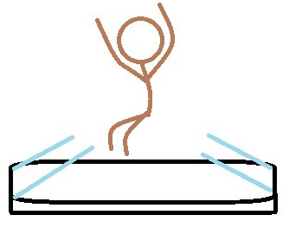
Galax•See
CEO: Jordan Lumpkin and Bianca Dessipe

Slide 2
The team
Jordan Lumpkin
CEO
Bianca Dessipe
CEO

Slide 3
What is galax•See?
Galax•See is a phone cases that is able to project any type of video or streaming.
This products helps you when you and others are trying to watch a video without having to struggle to watch the video on a phone while make sure that everyone can see.
“When no one can’t see it, turn it into a Galax•See so EVERYONE see’s it.” – Jordan Lumpkin, CEO
Everyone should care about Galax•See because it helps with watching many videos with friends and family.

Slide 4
Barriers of Entry
The product might malfunction and/ or the consumer might not be able to see the hologram clearly.
The product is new technology that some people may not have.

Slide 5
Economic impact:
The product will help the economy by servicing many people with Facebook accounts and protect their information with the futuristic feature. This will provide a safer environment on social media.

Slide 6
Partnership

