Slide 1
Cellphone Privacy
By: JHANYA WOODARD

Slide 2
Cell Phone Privacy

Slide 3
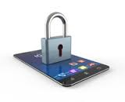
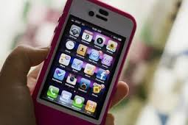

Slide 4
Cell Phone Privacy
Your Cell Phone Knows Where You Are:
Its a well known fact that our cell phones are area mindful. The area innovation that triangulates your position utilizing GPS or cell tower data is behind a large number of our cell phones' most helpful elements, from discovering awesome places adjacent to geotagging your photographs to consequently conveying rebates in light of the store you're in.

Slide 5
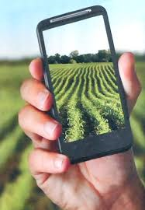
Mobile Apps Can Collect Your Location, Phone Number, and Other Personal Details
It's simpler to put a little trust in extensive organizations like Apple, Google, and Microsoft—they have a lot in question to hazard spying in a way that would truly crack a great many people out. Be that as it may, your telephone's working framework is only one thought. Applications may be gathering and transmitting significantly more insights about your telephone use and other data. The most evident reason is so advertisers can utilize that information to offer you more stuff or send focused on promotions, yet with a few applications.

Slide 6
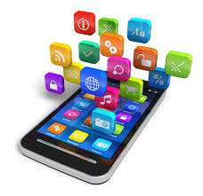
Private Sector:
There are 3 main things that a private sector collects & something can happen to it:
Lost in a data beach
The company misuses it
The government may use it

Slide 7
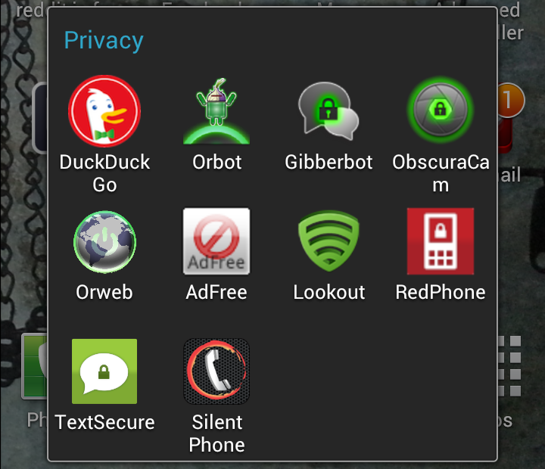
Mindsets To Help You Go Private:
Receive the attitude of just giving out the individual information that you totally should for instance, at checkout or when agreeing to an online record to fundamentally diminish your advanced foot shaped impression. Maintain a strategic distance from organizations that don't regard your security.

Slide 8
Government Potential:
In a potentially wide-ranging ruling, the court said that because cellphone owners technically "volunteer" their location to providers when they make phone calls, law enforcement agencies do not need a warrant to track an individual's location.

Slide 9
Flyer:

